Slide 1
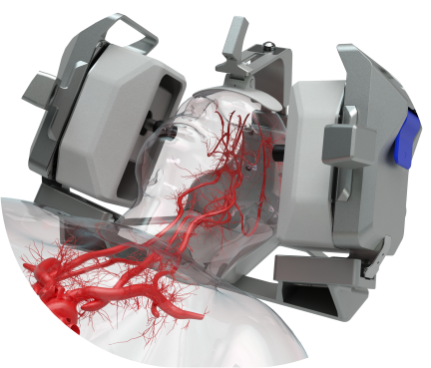
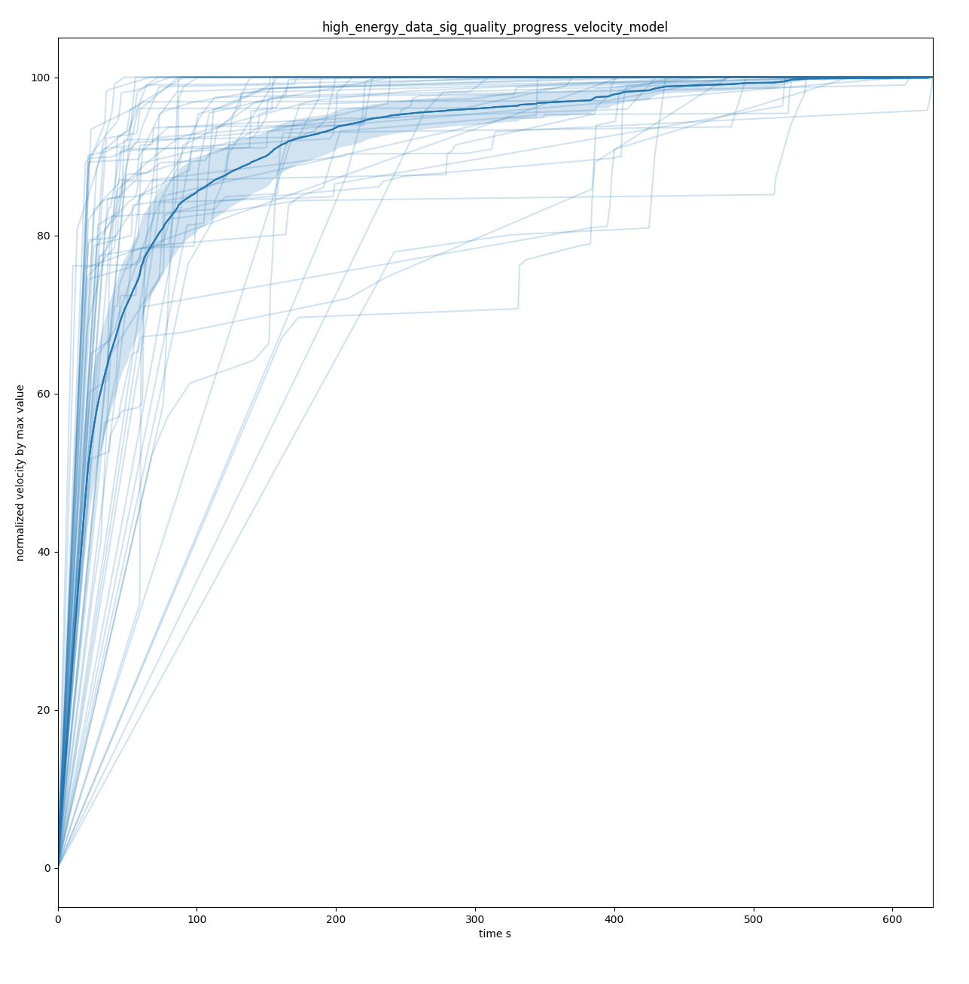
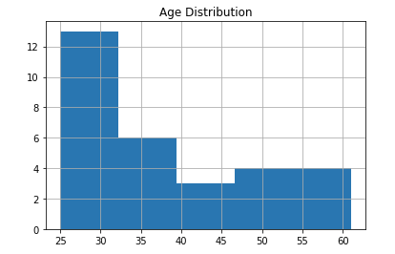
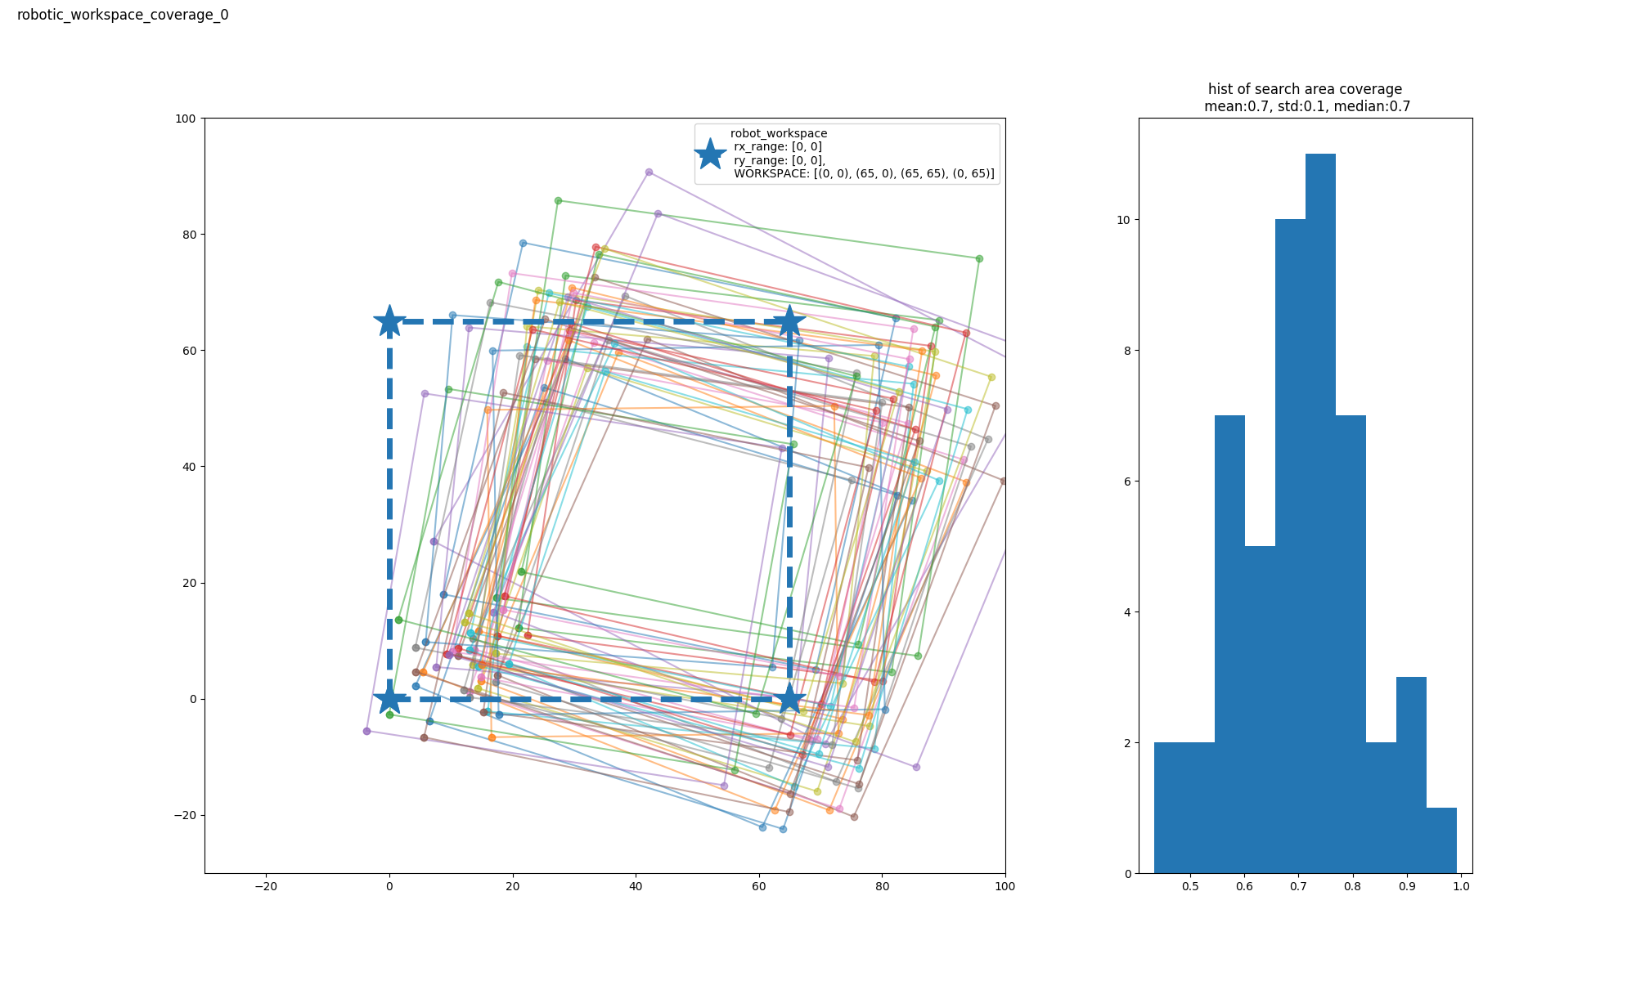
Fully Automated Robotic Controlled Transcranial Doppler Ultrasound Measurements Of Cerebral Blood Flow Velocity: Implications For Assessment Of Intracardiac Right-to-left Shunt
Mina Ranjbaran¹ │ Michael O’Brien¹ │ Zhaojun Nie¹ │ Shankar Radhakrishnan¹│ Robert Hamilton¹
¹ NovaSignal Corp. Los Angeles, CA.
Introduction
Methods
results
Presence of cardiac right-to-left shunt (RLS), usually through a patent foramen ovale (PFO), is shown to be a contributing factor to stroke and migraine.
Contrast transcranial Doppler (TCD) is proven to have excellent diagnostic accuracies that make it a safe, non-invasive and cost-efficient test for detecting RLS [1].
However, TCD is underutilized due to lack of expertise.
Insonation of at least one middle cerebral artery (MCA) is the minimum requirement for a diagnostic contrast TCD exam.
Automated robotic signal acquisition could vastly improve ease of use and level of expertise required on site.
On average, unilateral MCA signals are located for 86% (95% CI: 80-93%) of subjects within 1 min and 94% (95% CI: 89-98%) of subjects within 3 min of search.
Figure 1. Representation of the NovaGuide intelligent ultrasound when situated to perform an exam of the MCA.
results
Aims
We performed a retrospective analysis to evaluate the efficacy of the investigational NovaGuide Intelligent Ultrasound system for insonation of MCA blood flow to be used for contrast examination.
Figure 4. Normalized velocity by max velocity during search progress over time.
conclusions
Methods
In this retrospective analysis, we showed that investigational NovaGuide is highly efficient in insonating the MCA as the first requirement for contrast TCD examination.
Autonomous TCD allows any healthcare professional to perform an exam, and facilitates use of TCD as an efficient test for RLS diagnosis
Figure 2 Age distribution of included subjects.
Patient Population and Data Collection
Data was analyzed from 86 healthy volunteers who underwent robotically conducted TCD scans by NovaGuide Intelligent Ultrasound.
Subjects were consented under IRB, with average age 38 ± 12 years, 66% male.
NovaGuide search time was limited to a maximum of 10 minutes, with a 20-second signal evaluation time.
Performance indication is defined as percentage of scans with successful insonation of the MCA at 1 and 3 minutes after starting a NovaGuide search.
Selected References
[1] “Accuracy of Transcranial Doppler for the Diagnosis of Intracardiac Right-to-Left Shunt A Bivariate Meta-Analysis of Prospective Studies”, M. Khalid Mojadidi et al. doi: 10.1016/j.jcmg.2013.12.011.
Figure 3. Graphical representation of NovaGuide search area.
Questions?
robert@novasignal.com
For Research & Investigational Use Only. Not for Commercial Use.

